Slide 1

*****
Predicting Hotel Reservation Cancellations
Team : Anita Gjurchinovska, Kirby Judd, David Jolia, Chad Richards
A Slidesgo presentation

Slide 2

Contents:
Introduction
Methodology
Data Cleaning and Preprocessing
Data Analysis
Model Building and Evaluation
Results
Conclusion
Limitations
Contents

Slide 3


Introduction
Dataset of hotel reservations from Portugal
Predict hotel cancellations.
Objective was to gain insight into factors influencing cancellations.
Hotel Booking Demand Datasets
Nuno Antonio, Ana Almeida, and Luis Nunes, for Data in Brief, Volume 22, February 2019.
The dataset is publicly available on Kaggle:
https://www.kaggle.com/datasets/jessemostipak/hotel-booking-demand
Introduction

Slide 4

Methodology:
Pandas
Matplotlib
Scikit-Learn
SQL Database Postgres
SQLAlchemy
Psycopg2
Methodology

Slide 5
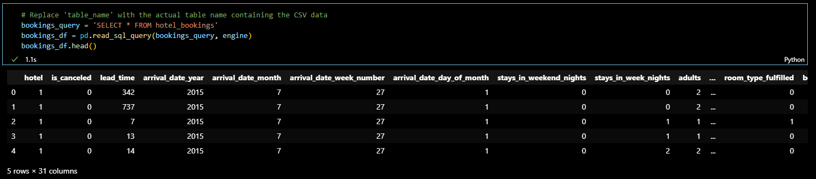
Data Cleaning and Preprocessing
Database Creation, Imports, and Jupyter Notebook:
Created “hotel_bookings_db” using pgAdmin.
Imported data into tables from CSV files.
Established a connection to the local Postgres database using psycopg2 in Jupyter Notebook.
Data Cleaning and Preprocessing

Slide 6
Data Cleaning and Preprocessing
Reviewed the original dataset for model development.
Created database schema and imported data.
Several columns dropped.
Text data replaced with integer id values.
Created two new columns to identify international origin and room type fulfillment.
Dropped NA’s.
Data Cleaning and Preprocessing

Slide 7
Data Analysis
1
Are there more cancellations during specific months?
2
Do different deposit types affect cancellations?
Questions:
3
Does lead time affect cancellations?
4
Does the origin of tourist (international or local) contribute to more or fewer cancellations?
Data Analysis

Slide 8
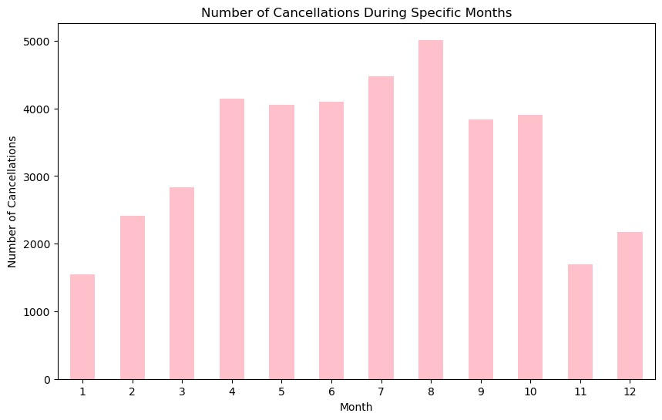
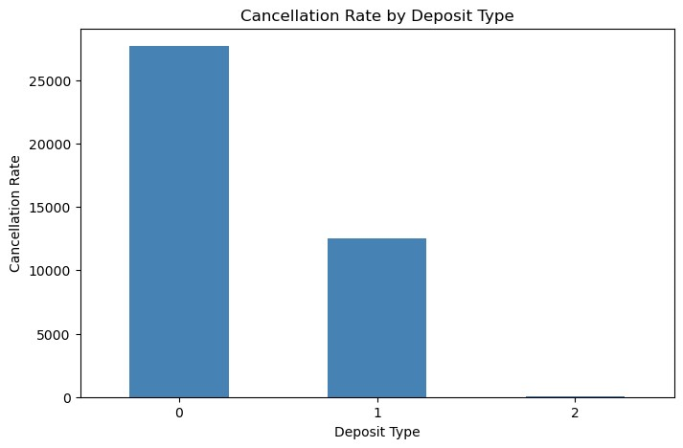
The data indicates that customers who opted for the “0- No Deposit” option were more likely to cancel their bookings compared to those who choose “1- Non-Refundable” or “2- Refundable” deposit options.
The analysis of the dataset revealed that the month of August experienced the highest number of cancellations compared to other months.
Data Analysis

Slide 9
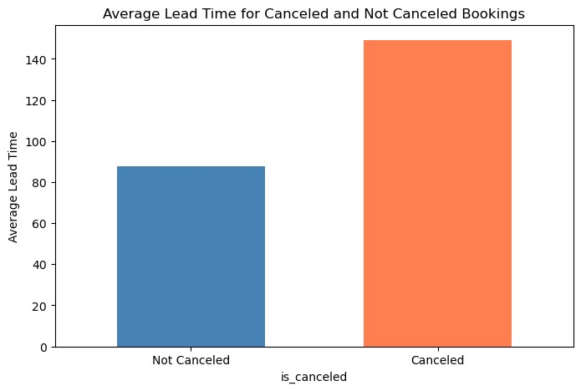
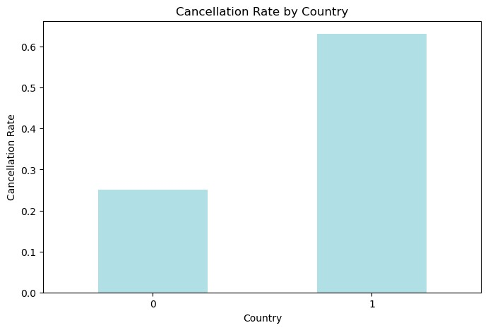
The bar plot shows cancellation rates between the 2 categories: 0- International, and 1- Not International. The “International” bar has height of 0.25, which means that around 25% of the bookings made by international guests were canceled. The “Not International” bar has height of 0.65, meaning that 65% of the bookings made by domestic guests were canceled.
The bar plot compares the average lead time for the “Cancelled” and “Not Cancelled” bookings. The “Not Cancelled” category has an average lead time of 90 days, while the “Cancelled” category has an average lead time of approximately 150 days.
Data Analysis

Slide 10
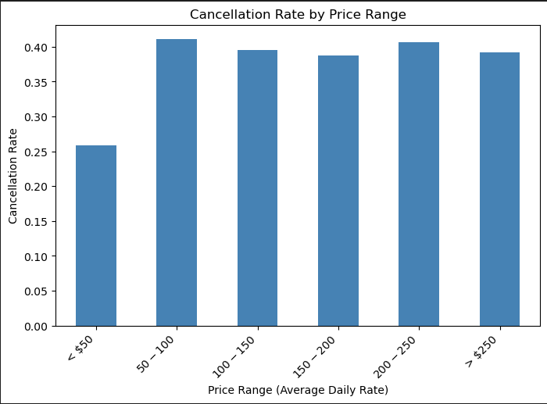
Data Analysis
This bar plot shows us the cancellation rates associated with different price ranges of hotel rooms. By analyzing this data, we can gain insights into whether higher prices lead to more cancellations, or if customers are more sensitive to price changes within specific price ranges. This understanding can help us optimize pricing strategies and potentially reduce cancellations by offering competitive prices in the most price-sensitive segments.

Slide 11
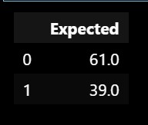
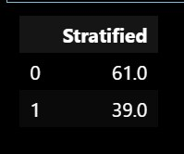
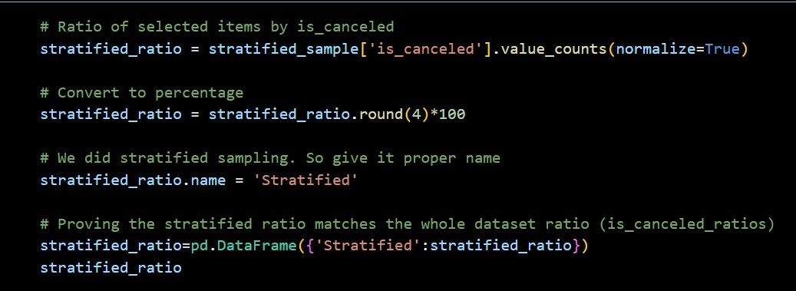
Model Building and Evaluation
Data stratification:
The dataset was stratified to create manageable testing and training subsets.
Model Building and Evaluation

Slide 12

Model Selection:
Three model were build and trained on the training data:
Logistic Regression
Random Forest
Decision Tree
Performance Metrics:
To evaluate the model performance on the test data were generated:
Confusion Matrix
Accuracy Score
Classification Reports
Model Building and Evaluation

Slide 13
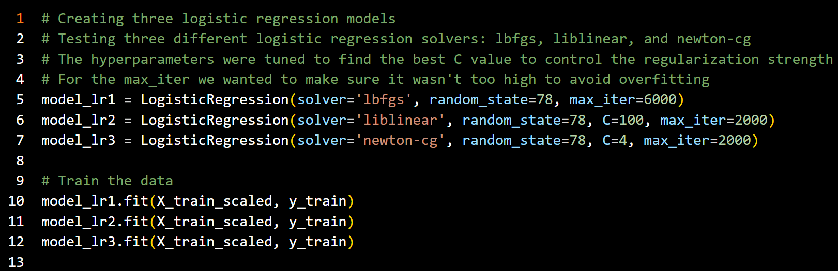
Hyperparameter Tuning
Model Building and Evaluation

Slide 14
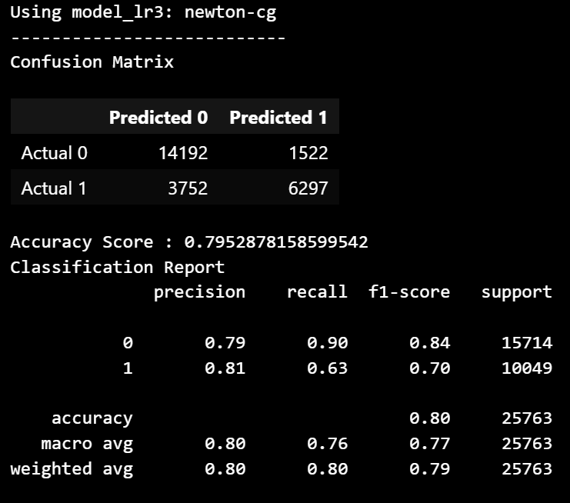
Logistic Regression
Model Building and Evaluation

Slide 15
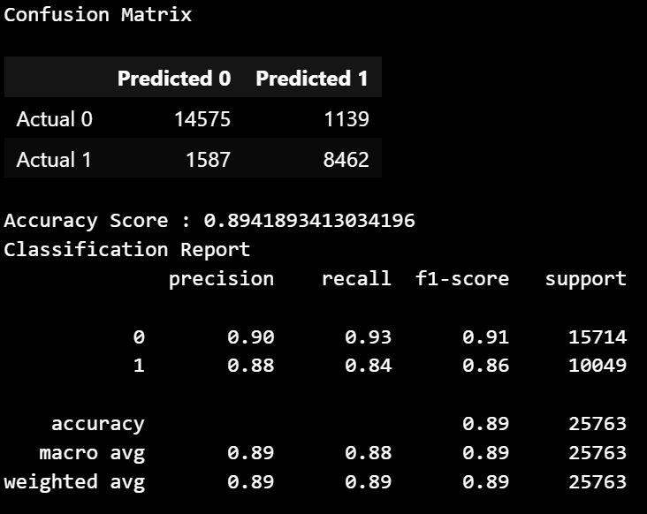
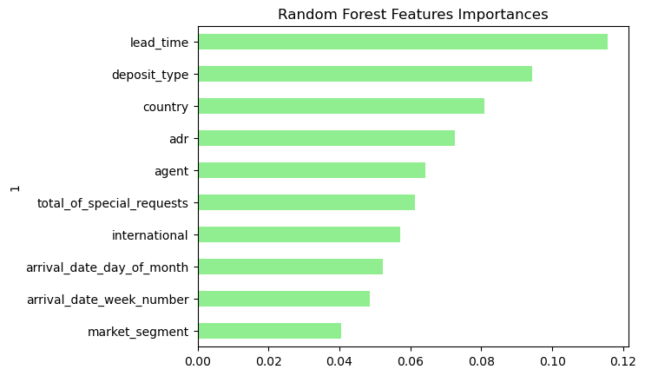
Random Forest
Model Building and Evaluation

Slide 16
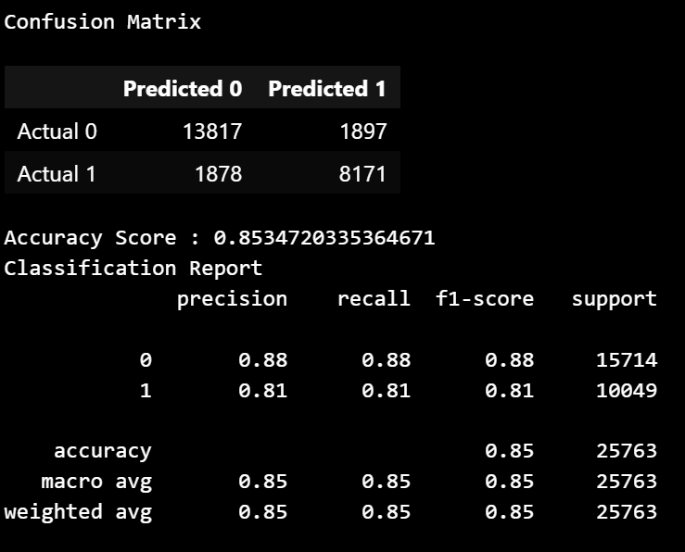
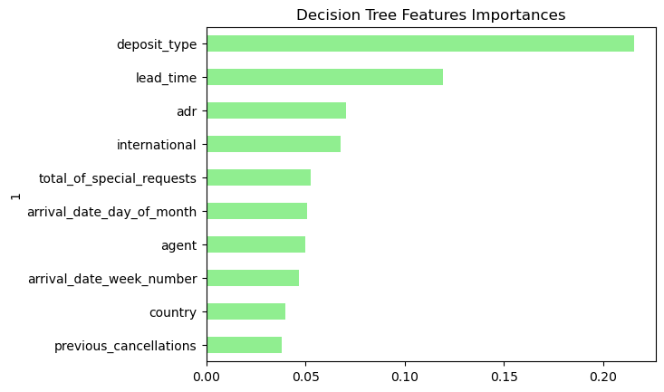
Decision Tree
Model Building and Evaluation

Slide 17
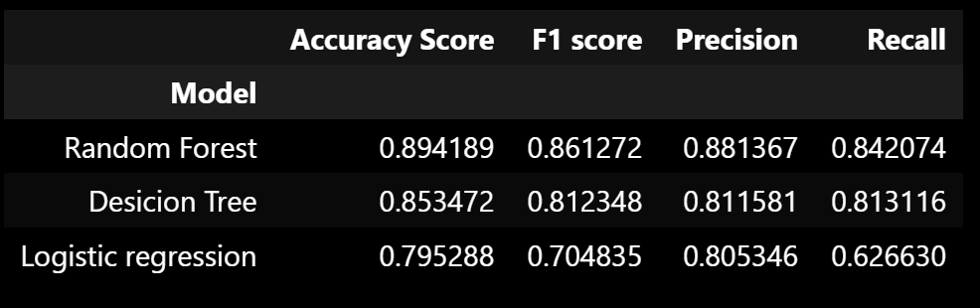
Results:

Slide 18

Conclusion:
The models are effective in identifying features contributing to cancellations.
Three features most important to predict cancellations:
-Deposit Type
-Country of Origin (Domestic vs International)
-Lead Time of Reservation
-Recommendations to Reduce Cancellations:
-Always charge a deposit
-Cater to international clients
-Reduce early booking window
-Optimize price strategies
Conclusion

Slide 19
Limitations:
Dataset from single country “Portugal”: The analysis is based on hotel reservation data from Portugal. As a result, the findings may not be directly applicable to hotels in other countries with different travel patterns and preferences.
Data Age (2015-2017): The data used in the analysis spans from 2015 to 2017, which may not fully capture the current trends and dynamics in the hospitality industry.
Pre-COVID Era: The dataset predates the COVID-19 pandemic, which significantly impacted the travel and hospitality industry. As a result, the predictive models may not accurately account for the post-COVID travel economy and uncertainties.
Limitations

Slide 20


Thank you!
Thank you!

